Slide 1

Hospital system operations
Grupo 9

Slide 2
Grupo 9
01
04
Jaciana Beatriz
Maryanna
02
05
Lucas Soares
Rafael Sampaio
03
06
Luiz Felipe
Samuel Vinicios

Slide 3

Agenda
01
Apresentação
05
09
Site/ Jar/ EC2/ Azure/ Log
Métricas
02
Contexto
06
Slack
10
Conclusão
03
Diagrama de Solução Técnico
07
Container/Docker
11
Agradecimentos
04
Inovação
08
Diagrama de Classe

Slide 4

Contextualização

Slide 5
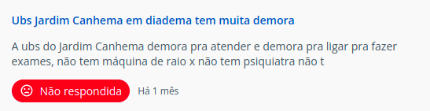
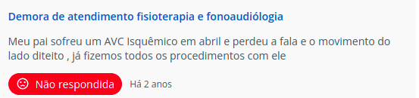
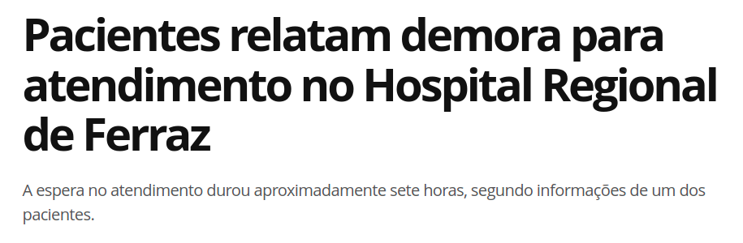
Sobre nós
Missão
Valores
Visão
Somos uma empresa de tecnologia com ênfase em monitoramento de máquinas.
Otimização dos atendimentos, menos paralizações dos softwares no meio do expediente
Excelência
Agilidade
Compromisso
Melhorar a experiência dos pacientes em consultórios.
02.
03.
04.
05.
Problema
product new
wing
develop
new wing
Demora em atendimentos devido a panes nos Sistemas Operacionais.
Por muitos relatos e por experiência própria concluímos que há necessidade de um monitoramento das máquinas para diminuir a ocorrência dessas panes.

Slide 6
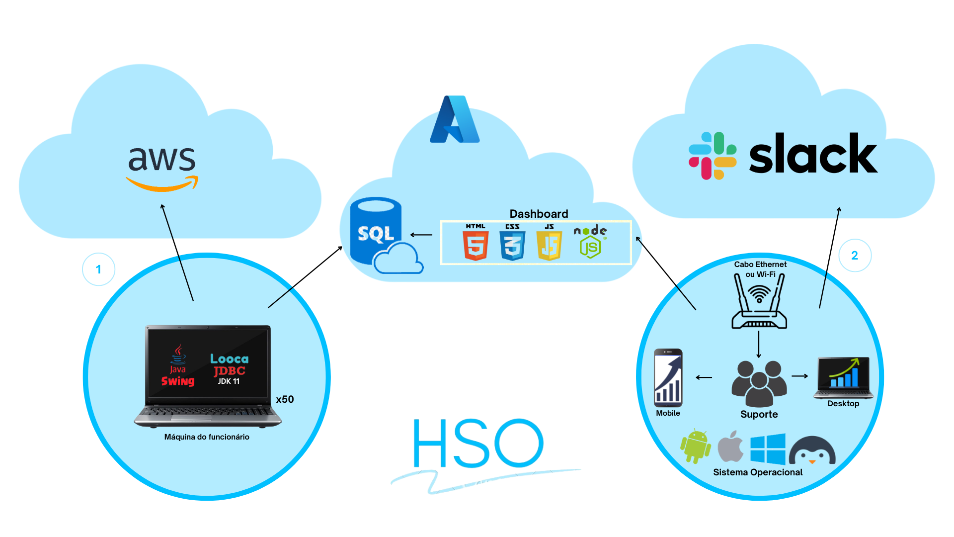
Diagrama de soução técnico

Slide 7
Nosso Produto

Slide 8





Slide 9
Conclusão
Acreditamos que com nosso produto otimizaremos os atendimentos em hospitais, contribuindo para uma melhora na saúde de todo país, e numa melhor experiencia de pacientes e funcionários.

Slide 10




Agradecimentos
Gostaríamos de agradecer à nossa equipe pelo empenho no desenvolvimento do nosso projeto.
Ao nosso cliente, pela confiança em nosso trabalho.
Aos professores por todo apoio e conhecimento.
E às nossas empresas pela oportunidade de aprendizado e experiência.

Slide 11
01
Enter title
Text here
Please enter your copy, please enter your copy, please enter your copy, please enter your copy, please enter your copy, please enter your copy, please enter your copy
Please ent
02
Please enter your copy, please enter your copy, please enter your copy, please enter your copy, please enter your copy, please enter your copy, please enter your copy
Please enter your copy, please enter your copy, please enter your copy, please enter your copy, please enter your copy, please enter your copy, please enter your copy
Our destiny offers not the cup of despair, but the chalice of opportunity.
So let us seize it, not in fear,
but in gladness but the chalice of opportunity. So let us seize it,
not in fear, but in gladness Our destiny offers not
Text here
Please enter your copy, please enter your copy, please enter your copy, please enter your copy, please enter your copy, please enter your copy, please enter your copy
03
Text here
Please enter your copy, please enter your copy, please enter your copy, please enter your copy, please enter your copy, please enter your copy, please enter your copy

Slide 12
Enter title
Enter title
Enter title
Enter title
Enter title
Please enter your copy, please enter your copy, please enter your copy, please enter your copy, please enter your copy, please enter your copy, please enter your copy
Please enter your copy, please enter your copy, please enter your copy, please enter your copy, please enter your copy, please enter your copy, please enter your copy
Please enter your copy, please enter your copy, please enter your copy, please enter your copy, please enter your copy, please enter your copy, please enter your copy
Please enter your copy, please enter your copy, please enter your copy, please enter your copy, please enter your copy, please enter your copy, please enter your copy

Slide 13
03
Please enter a text title

Slide 14
Please ent
Please enter your copy, please enter your copy, please enter your copy, please enter your copy, please enter your copy, please enter your copy, please enter your copy
20NN
20NN
20NN
20NN
Please enter your copy, please enter your copy, please enter your copy, please enter your copy, please enter your copy, please enter your copy, please enter your copy
Please enter your copy, please enter your copy, please enter your copy, please enter your copy, please enter your copy, please enter your copy, please enter your copy
Please enter your copy, please enter your copy, please enter your copy, please enter your copy, please enter your copy, please enter your copy, please enter your copy
Please enter your copy, please enter your copy, please enter your copy, please enter your copy, please enter your copy, please enter your copy, please enter your copy

Slide 15
Please ent
Title Content
Please enter your copy, please enter your copy, please enter your copy, please enter your copy, please enter your copy, please enter your copy, please enter your copy
Please enter your copy, please enter your copy, please enter your copy, please enter your copy, please enter your copy, please enter your copy, please enter your copy

Slide 16
Please enter your title content
01.
02.
03.
04.
05.
new wing
product new
wing
develop
new wing
Please enter your copy, please enter your copy, please enter your copy, please enter your copy, please enter your copy, please enter your copy, please enter your copy
Please enter your copy, please enter your copy, please enter your copy, please enter your copy, please enter your copy, please enter your copy, please enter your copy
Please enter your copy, please enter your copy, please enter your copy, please enter your copy, please enter your copy, please enter your copy, please enter your copy
Please enter your copy, please enter your copy, please enter your copy, please enter your copy, please enter your copy, please enter your copy, please enter your copy
Please enter your copy, please enter your copy, please enter your copy, please enter your copy, please enter your copy, please enter your copy, please enter your copy

Slide 17
Please enter your title content
Enter title
Enter title
Please enter your copy, please enter your copy, please enter your copy, please enter your copy, please enter your copy, please enter your copy, please enter your copy
Please enter your copy, please enter your copy, please enter your copy, please enter your copy, please enter your copy, please enter your copy, please enter your copy
Enter title
Enter title
Please enter your copy, please enter your copy, please enter your copy, please enter your copy, please enter your copy, please enter your copy, please enter your copy
Please enter your copy, please enter your copy, please enter your copy, please enter your copy, please enter your copy, please enter your copy, please enter your copy

Slide 18
Please enter your title content
Enter title
Enter title
Enter title
Enter title
Please enter your copy, please enter your copy, please enter your copy, please enter your copy, please enter your copy, please enter your copy, please enter your copy
Please enter your copy, please enter your copy, please enter your copy, please enter your copy, please enter your copy, please enter your copy, please enter your copy
Please enter your copy, please enter your copy, please enter your copy, please enter your copy, please enter your copy, please enter your copy, please enter your copy
Please enter your copy, please enter your copy, please enter your copy, please enter your copy, please enter your copy, please enter your copy, please enter your copy
01
02
03
04

Slide 19


Please ent
Please enter your copy, please enter your copy, please enter your copy, please enter your copy, please enter your copy, please enter your copy, please enter your copy
Please enter your copy, please enter your copy, please enter your copy, please enter your copy, please enter your copy, please enter your copy, please enter your copy
Enter title
Enter title

Slide 20
Please enter your title content
Enter title
Enter title
Enter title
Enter title
Please enter your copy, please enter your copy,
Please enter your copy, please enter your copy,
Please enter your copy, please enter your copy,
Please enter your copy, please enter your copy,
Enter title
Please enter your copy, please enter your copy, please enter your copy, please enter your copy, please enter your copy, please enter your copy, please enter your copy

Slide 21
Please ent
Please enter your copy, please enter your copy, please enter your copy, please enter your copy, please enter your copy, please enter your copy, please enter your copy
Please ent
Please enter your copy, please enter your copy, please enter your copy, please enter your copy, please enter your copy, please enter your copy, please enter your copy

Slide 22
06
Please enter a text title

Slide 23
Please ent
Enter title
01
Please enter your copy, please enter your copy, please enter your copy, please enter your copy,
Enter title
Enter title
Please enter your copy, please enter your copy, please enter your copy, please enter your copy,
02
Please enter your copy, please enter your copy, please enter your copy, please enter your copy, please enter your copy, please enter your copy, please enter your copy
Enter title
Please enter your copy, please enter your copy, please enter your copy, please enter your copy, please enter your copy, please enter your copy, please enter your copy
03
Please enter your copy, please enter your copy, please enter your copy, please enter your copy,

Slide 24
Please enter your title content
Please enter your copy, please enter your copy, please enter your copy, please enter your copy, please enter your copy, please enter your copy, please enter your copy
Enter title
Enter title
Enter title
Enter title
Please enter your copy, please enter your copy, please enter your copy, please enter your copy,
Please enter your copy, please enter your copy, please enter your copy, please enter your copy,
Please enter your copy, please enter your copy, please enter your copy, please enter your copy,
Please enter your copy, please enter your copy, please enter your copy, please enter your copy,
01
02
03
04

Slide 25
Thanks for watching

